Slide 1
CPWA Overview
IFME Joint Meeting
April 18, 2016
Notes:
Thanks for sharing all that information with us Rick! There’s loads going on with APWA and available to all OPWA members.
Now it’s my turn to tell you about a bit about what the Canadian Public Works Association is up to….

Slide 2
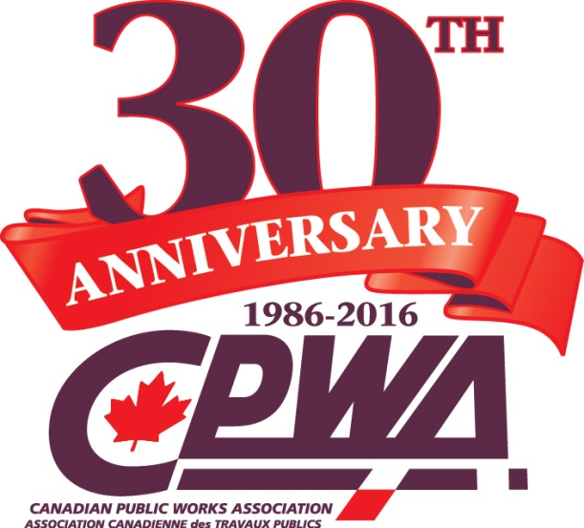
Canadian Public Works Association
Provides a voice for Public Works in Canada
Advocacy and Outreach at the Federal Level
Eight Canadian Chapters are represented by a Board of Directors
Notes:
CPWA was created to provide a voice for public works in Canada
And what that means, is that CPWA has a very specific mandate around Advocacy and Outreach at the Federal level. As you heard, APWA national and the chapters provide the resources, training, education and advocacy at the local and provincial level, which allows CPWA to focus our activities in Ottawa and with the Canadian government.
CPWA is governed by a Board of Directors representing the eight Canadian chapters and it’s this Board that sets the priorities and activities for CPWA each year.
2016 marks the 30th anniversary of CPWA and today is the unveiling of our special new logo to commemorate the milestone!

Slide 3
CPWA Outreach: National Public Works Week Campaign
Proclamations
Event Promotion
Awards Program
Notes:
In terms of outreach activities, the NPWW Campaign to promote the important work of public works professionals across the county is a significant annual activity for CPWA.
We assist chapters in seeking proclamations from all of the provinces and territories and also from the Prime Minister’s office, which serves to highlight public works in the political arena.
National Public Works Week is promoted through CPWA social media channels, email, our website, and media releases.
Finally, to encourage participation in NPWW, CPWA has an developed annual awards to recognize the best NPWW programs from across the country. This not only generates some healthy competition but the award presentations also serves as another opportunity to highlight public works.

Slide 4
CPWA Outreach at PWX:
CPWA Luncheon
CPWA International Infrastructure Roundtable
CPWA Educational Session
Notes:
Another opportunity for outreach to our Canadian members is at Public Works Expo (or the event formerly known as Congress).
Every year, CPWA hosts a luncheon featuring a current topic or speaker…for example, last year in Pheonix, Brock Carlton, CAO of the Federation of Canadian Municipalities gave us some terrific pre-election insight.
We also host an International Infrastructure roundtable at PWX which is a terrific opportunity for public works professionals around the globe to share best practices.
And finally, every year CPWA hosts a Canadian content focussed education session…as an example, last year both Alan and I led the session which highlighted what going on in Ottawa pre-election while the previous year was a moderated panel discussing the pro’s and con’s of P3’s in Canada.

Slide 5
CPWA Advocacy Priorities
Dependable infrastructure funding
Build municipal capacity in asset management
Sustainable public works projects
Notes:
So that brings us to CPWA advocacy activities…
The Board has set some key priorities that form the basis of all our discussions with federal government politicians and their staff…
The first is that municipalities need dependable, predictable infrastructure funding.
Second, the we need to build capacity in municipal asset management…
And third, we need to embed sustainability in all public works projects.
There are clearly many sub-points to these key priorities depending on who we are talking to, but these three areas are the root or guiding principles when it comes to CPWA’s advocacy efforts.
So that’s the what, now how have we gotten the message across….?

Slide 6
Working With Others
The Municipal Infrastructure Forum – “one voice” for infrastructure
2012 and 2016 Canadian Infrastructure Report Card
Notes:
Over the years, CPWA has built and continued to strengthen relationships with other like minded infrastructure stakeholders like FCM, Engineers Canada, the Canadian Construction Association, the Canadian Society for Civil Engineers, Canadian Network of Asset Managers, and others who help amplify our message.
The Municipal Infrastructure Forum has been a successful collaboration that created a united voice for input to the federal government on the New Build Canada Plan and more recently, last year during the Federal election campaign period and currently as we head into the federal budget under the new Liberal government.
And of course, the Canadian Infrastructure Report Card was another major collaborative project for CPWA and CPWA is one of the CIRC founding partners.

Slide 7
Canadian Infrastructure Report Card
Assess the health of Canada’s municipal infrastructure
Raise awareness on the key infrastructure challenges Canada is facing
Inform stakeholders about issues and trends to enable evidence-based decision making
NOT prescriptive
Notes:
The Canadian Infrastructure Report Card (CIRC) provides an assessment of the health of municipal infrastructure as reported by cities and communities across Canada.
It is not a prescriptive document – in other words, it does not provide recommendations for action, nor does it forecast future capital requirements resulting from municipal growth.
However, it does raise awareness on the key infrastructure challenges Canada is facing
And it informs stakeholders about issues and trends to enable evidence-based decision making

Slide 8
2012 Canadian Infrastructure Report Card
Provided much-needed data at a time when CPWA and other stakeholders were advocating for a Long-Term Infrastructure Plan (LTIP)
Report pointed to a demonstrable need for infrastructure investments to maintain and improve service levels
Shed light on asset management practices in Canada
Notes:
The 2016 Canadian Infrastructure Report Card builds and improves on the first CIRC, published in 2012.
Before the 2012 Report Card, there had been many attempts to achieve a similar product but none quite so wide ranging. The organizations involved in this project believed that working together towards a shared objective was a better use of resources than working parallel to each other.
The Steering Committee was composed of Canadian Public Works Association, Federation of Canadian Municipalities, Canadian Construction Association, and Canadian Society for Civil Engineers
The Report Card was generated using survey results from 123 municipalities representing almost 20 million Canadians.
It provided an assessment of the condition of four primary asset categories of municipal infrastructure: drinking-water systems, wastewater and stormwater networks, and municipal roads.
The Report Card provides information on a number of factors, including the physical condition of the infrastructure, the available capacity, the value of the infrastructure systems, and the type of management systems that are used to collect information and make infrastructure investment decisions.
The Report did not include recommendations for changes to infrastructure policies or actions since was carried out as objective assessment but it certainly demonstrated the need for infrastructure investments.
What also became apparent through the data collection process is that many municipalities across the country lack capacity to accurately assess their infrastructure
In fact, 346 municipalities registered – but less than half – only 123 - had adequate data to actually participate

Slide 9
2016 CIRC: New asset classes, new approach
Expanded to include new asset classes: municipal bridges, buildings, sport and recreation facilities and public transit systems
Federal-Provincial/Territorial Sport Committee (FPTSC) and the Canadian Urban Transit Association (CUTA) provided funding to support expansion
Notes:
So, much was learned from the 2012 results and so the 2016 report contains some enhancements.
The report card has been expanded to included information on the state of municipal transit, sport and recreation infrastructure, buildings, asset management, and local bridges.
To assist with these new asset classes, two new associations were added to the steering committee: the Federal-Provincial/Territorial Sport Committee (FPTSC) and the Canadian Urban Transit Association (CUTA) which provided funding to support expansion
The muncipal Survey questionnaire was refined form 2012 and launched in October 2014 – and I hope that many of you municipal folks in the room participated.

Slide 10
2016 CIRC: Key findings
“One-third of our municipal infrastructure is in fair, poor or very poor condition, increasing the risk of service disruption.”
Notes:
First key finding:
More than a third of our municipal infrastructure is in fair, poor or very poor condition, increasing the risk of service disruptions and the cost of repairs that are deferred into the future.
The survey asked municipalities to qualitatively assess their infrastructure according to a five-point rating scale ranging from Very Good to Very Poor
The results show that nearly 35% of assets overall are in need of attention. Assets in fair, poor and very poor conditions represent a call for action.

Slide 11
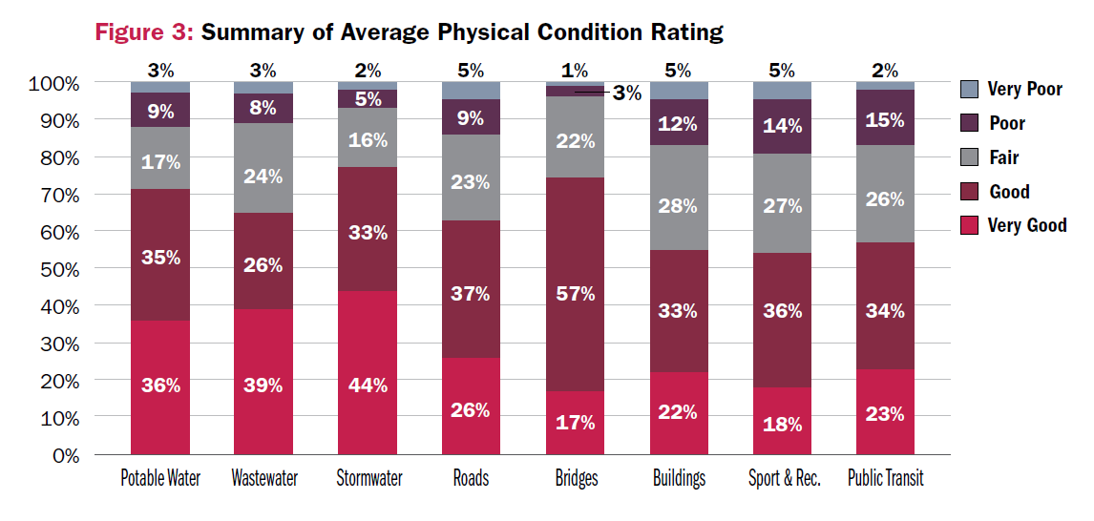
2016 CIRC: Key findings
Notes:
This figure from the report provides a summary of the physical condition ratings by asset classes.
Not sure how well you can see it…
It demonstrate that roads, municipal buildings, sport and recreation facilities and public transit are the asset classes most in need of attention.

Slide 12
2016 CIRC: Key findings
“Current rates of reinvestment are lower than targets recommended by asset management practitioners.”
Notes:
Second key finding:
Increasing reinvestment rates will stop the deterioration of municipal infrastructure.
The 2016 CIRC found that rates of reinvestment are lower than targets recommended by asset management practitioners. The rate can vary based on factors such as the age of the infrastructure, the level of service and risk tolerance. The recommended values provided in the report are based on the experience of municipal asset management practitioners and are intended to be informative in nature.

Slide 13
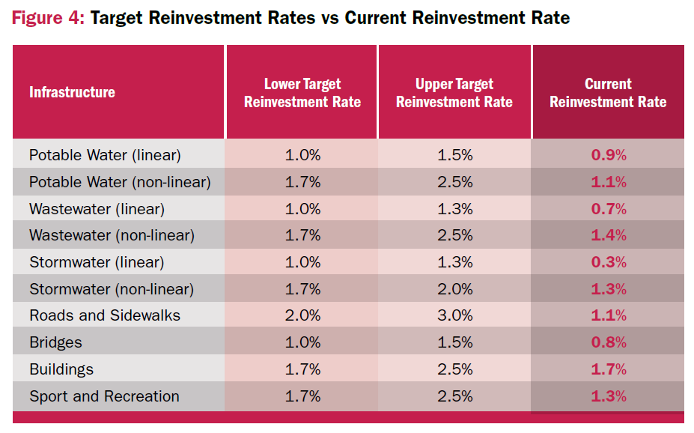
2016 CIRC: Key findings
Notes:
This figure demonstrates the gap between current and target reinvestment levels for each asset class.
Roads and sidewalks, storm water, and sport and recreation infrastructure presented the largest gaps in terms of current and target rates of reinvestment, with water systems-related facilities not far behind.
Continuing down this path will result in a gradual decline of physical condition levels that will impact municipal services.
When contrasted with target reinvestment rates, it becomes clear that current levels of reinvestment in municipal infrastructure are inadequate.

Slide 14
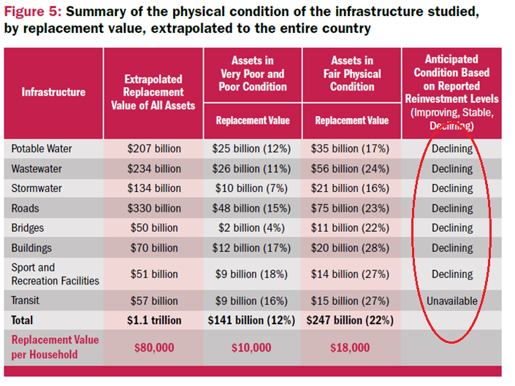
Notes:
Continuing down this path will result in a gradual decline of physical condition levels that will impact municipal services.
When contrasted with target reinvestment rates, it becomes clear that current levels of reinvestment in municipal infrastructure are inadequate.

Slide 15
2016 CIRC: Key findings
“Increasing reinvestment rates will stop the deterioration of municipal infrastructure – and save money in the long-term”
Notes:
Increasing reinvestment rates will save money in the long-term.
Without an increase in current reinvestment rates, the condition of Canada’s core municipal infrastructure will gradually decline, costing more money and risking service disruption.

Slide 16
2016 CIRC: Key findings
“Building for today’s communities and tomorrow’s Canada requires long-term planning.”
Notes:
Building for today’s communities and tomorrow’s Canada requires long-term planning.
Survey results demonstrate that, if our current rates of reinvestment do not change, the condition of Canada’s existing municipal infrastructure will decline.
A long-term plan is needed to ensure our communities can continue to rely upon essential public services without disruption. This would also allow municipalities to plan for projected population growth, keep up with technological innovation, and deal with the increasing impact of extreme weather events.

Slide 17
2016 CIRC: Key findings Asset Management
Reported having a formal asset management plan in place:
62% of large municipalities
56% of medium-sized municipalities
35% of small municipalities
Notes:
But, One of the challenges we face is building the capacity of local governments to use asset management practices to manage their local infrastructure to ensure good long term planning.
The 2016 Report Card found that almost two thirds of larger cities have a formal asset management process but in smaller municipalities that drops to just a third.
Building this capacity requires a commitment and support from the federal, provincial and territorial governments.

Slide 18
2016 CIRC: Key findings Asset Management
Reported publishing a State of infrastructure report (SOIR):
63% of large municipalities
56% of medium-sized municipalities
10% of small municipalities
Notes:
Further, nearly 40% of responding municipalities reported publishing a state of infrastructure report (SOIR).
Once again, results varied according to the size of the municipality. Only 10% of small municipalities reported publishing an SOIR, whereas levels reached 56% for medium-sized municipalities and 63% for large municipalities.
Therefore it is clear that all communities, particularly smaller municipalities, would benefit from increased asset management capacity.

Slide 19
2016 CIRC: Key findings
“Current rates of reinvestment are lower than targets recommended by asset management practitioners.”
Notes:
Second key finding:
Increasing reinvestment rates will stop the deterioration of municipal infrastructure.
The 2016 CIRC found that rates of reinvestment are lower than targets recommended by asset management practitioners. The rate can vary based on factors such as the age of the infrastructure, the level of service and risk tolerance. The recommended values provided in the report are based on the experience of municipal asset management practitioners and are intended to be informative in nature.

Slide 20
2016 CIRC: Key findings
Notes:
This figure demonstrates the gap between current and target reinvestment levels for each asset class.
Roads and sidewalks, storm water, and sport and recreation infrastructure presented the largest gaps in terms of current and target rates of reinvestment, with water systems-related facilities not far behind.
Continuing down this path will result in a gradual decline of physical condition levels that will impact municipal services.
When contrasted with target reinvestment rates, it becomes clear that current levels of reinvestment in municipal infrastructure are inadequate.

Slide 21
Notes:
Continuing down this path will result in a gradual decline of physical condition levels that will impact municipal services.
When contrasted with target reinvestment rates, it becomes clear that current levels of reinvestment in municipal infrastructure are inadequate.

Slide 22
2016 CIRC: Key findings
“Increasing reinvestment rates will stop the deterioration of municipal infrastructure – and save money in the long-term”
Notes:
Increasing reinvestment rates will save money in the long-term.
Without an increase in current reinvestment rates, the condition of Canada’s core municipal infrastructure will gradually decline, costing more money and risking service disruption.

Slide 23
2016 CIRC: Key findings Asset Management
Reported having a formal asset management plan in place:
62% of large municipalities
56% of medium-sized municipalities
35% of small municipalities
Notes:
But, One of the challenges we face is building the capacity of local governments to use asset management practices to manage their local infrastructure to ensure good long term planning.
The 2016 Report Card found that almost two thirds of larger cities have a formal asset management process but in smaller municipalities that drops to just a third.
Building this capacity requires a commitment and support from the federal, provincial and territorial governments.

Slide 24
2016 CIRC: Key findings Asset Management
Reported publishing a State of infrastructure report (SOIR):
63% of large municipalities
56% of medium-sized municipalities
10% of small municipalities
Notes:
Further, nearly 40% of responding municipalities reported publishing a state of infrastructure report (SOIR).
Once again, results varied according to the size of the municipality. Only 10% of small municipalities reported publishing an SOIR, whereas levels reached 56% for medium-sized municipalities and 63% for large municipalities.
Therefore it is clear that all communities, particularly smaller municipalities, would benefit from increased asset management capacity.

Slide 25
2016 CIRC: Key findings
“Building for today’s communities and tomorrow’s Canada requires long-term planning.”
Notes:
Building for today’s communities and tomorrow’s Canada requires long-term planning.
Survey results demonstrate that, if our current rates of reinvestment do not change, the condition of Canada’s existing municipal infrastructure will decline.
A long-term plan is needed to ensure our communities can continue to rely upon essential public services without disruption. This would also allow municipalities to plan for projected population growth, keep up with technological innovation, and deal with the increasing impact of extreme weather events.

